Slide 1
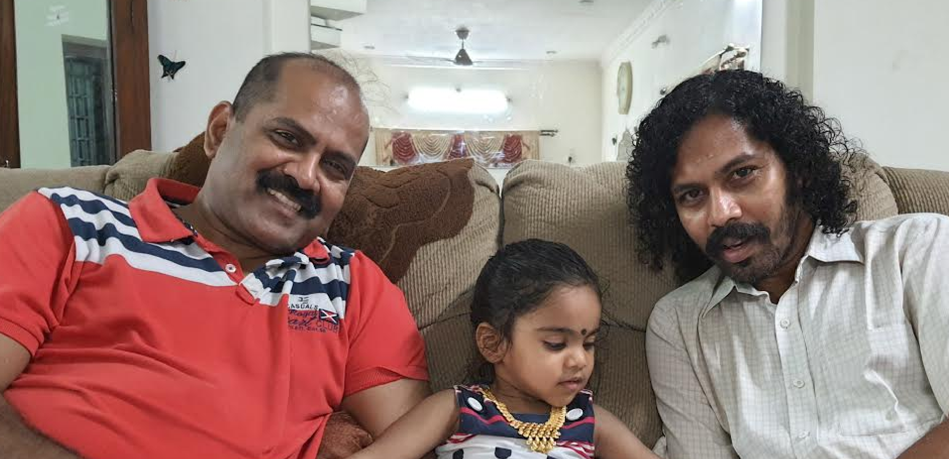
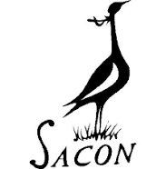

Mahendiran Mylswamy¹ & Parthiban Mylswamy²
Senior Scientist, Division of Wetland Ecology Salim Ali Centre for Ornithology and Natural History (SACON), Anaikatty, Coimbatore – 641108, Tamil Nadu, India.
2) Assistant Professor (Computer Science) Agricultural College & Research Institute,
Tamil Nadu Agricultural University (TNAU),
Coimbatore - 641 003, Tamil Nadu, India.

Slide 2
Main research interest includes
Ecology and evolutionary questions using birds as model species
Morphology
Non-invasive measurements of animal morphology
Size and Shape (Geometric Morphometrics)
Behaviour
Behavioural studies on the social interactions of Babblers, Sarus Crane, Painted Stork, Cormorants etc.
Ecology
Coexistence of (Sympatric/Allopatric) species (Geometric Morphometrics)
Estimation of animal population (Abundance and distribution)
Distance Sampling techniques

Slide 3
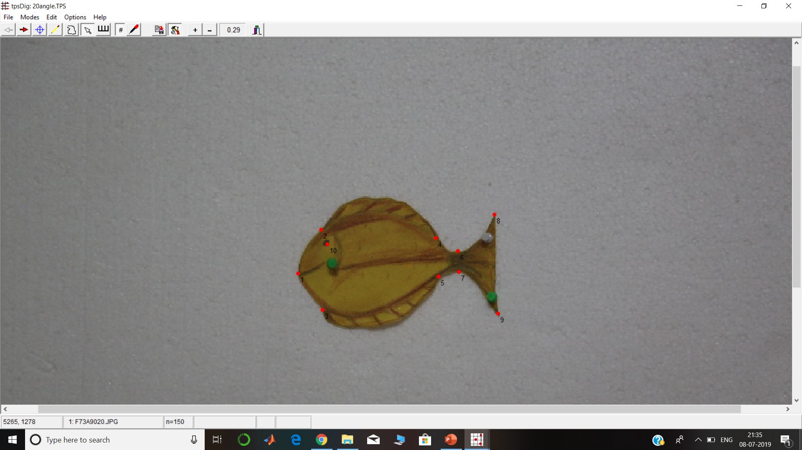
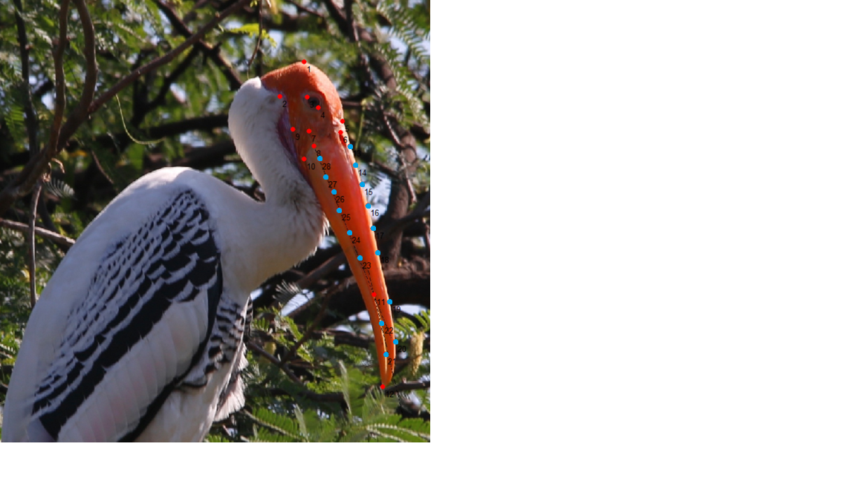
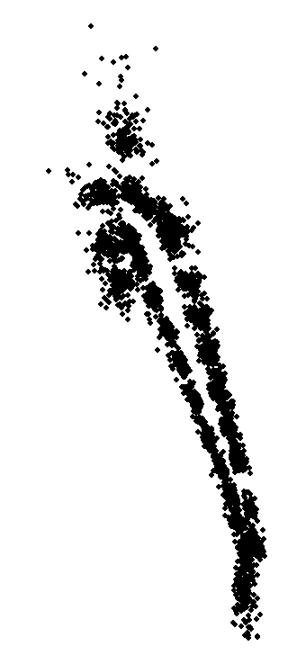
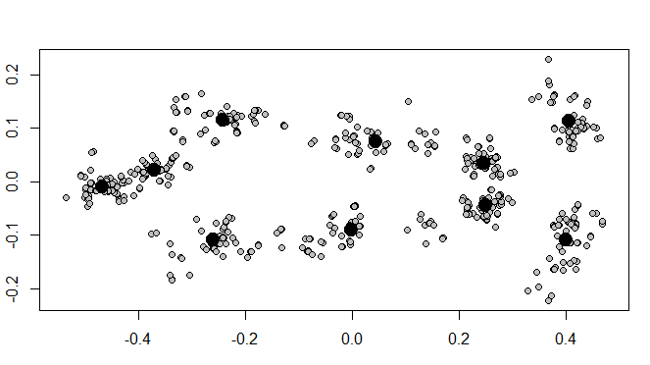
Shape Analysis of Cardboard Model Fish, and Painted Stork (Mycteria leucocephala)

Slide 4
Main research interest involves (Parthi)
We use advanced computational tools and techniques to answer the questions in ecology & evolution.
Non-invasive ways of estimation of shape and size
In situ estimation of animal morphology using digital photographs and their metadata.
Standardizing 2D Geometric morphometric
Resampling techniques to test models
Softwares we use:
TPS
WEKA
R & Python, OpenCV
Application of the Cloud Computation Platform

Slide 5
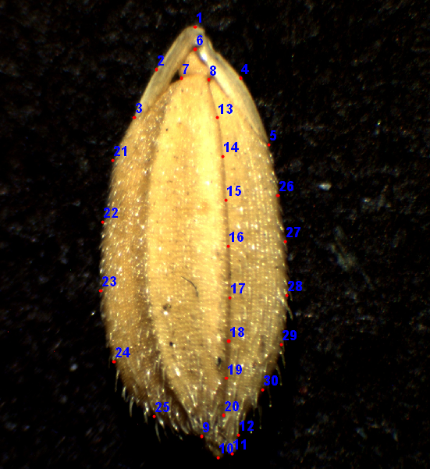
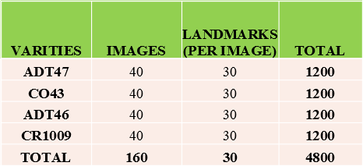
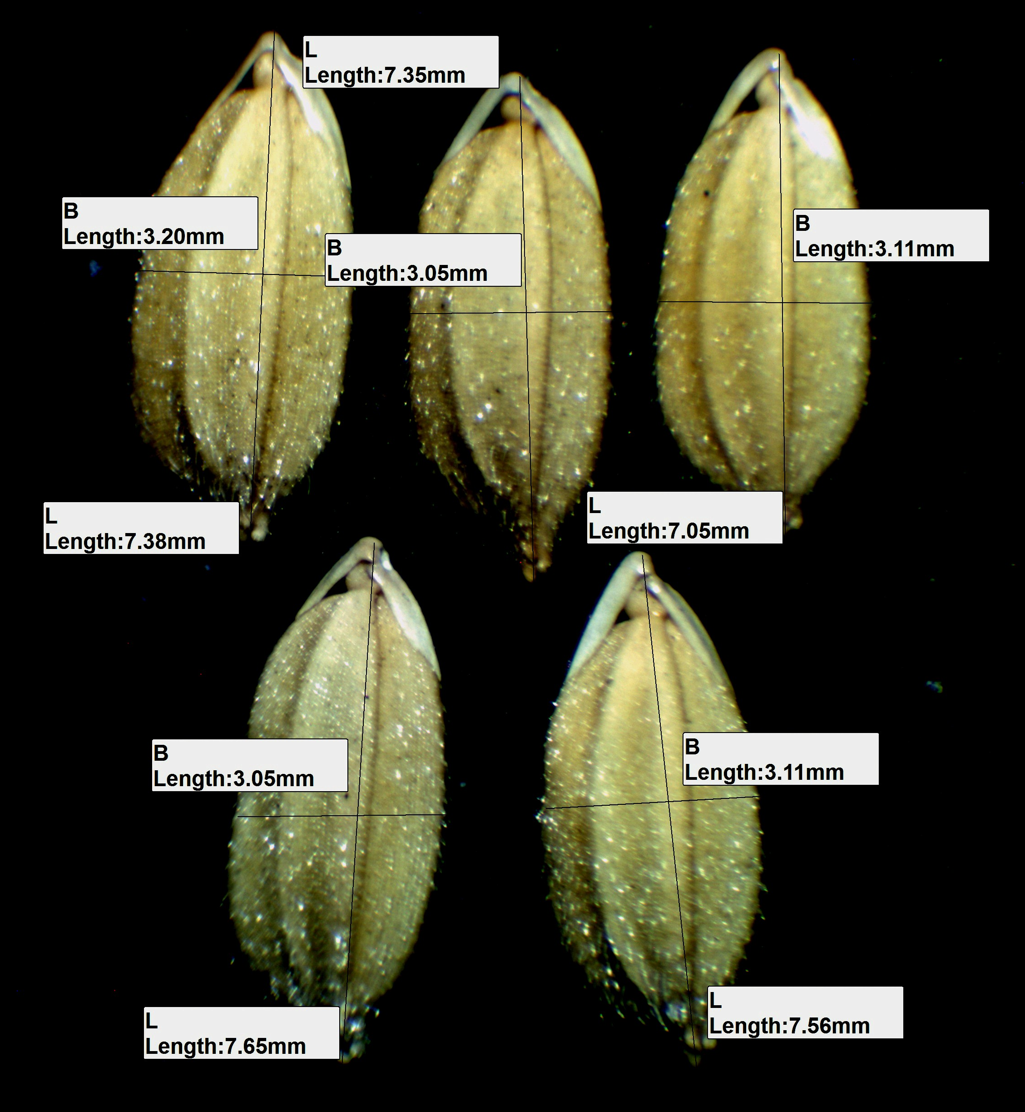
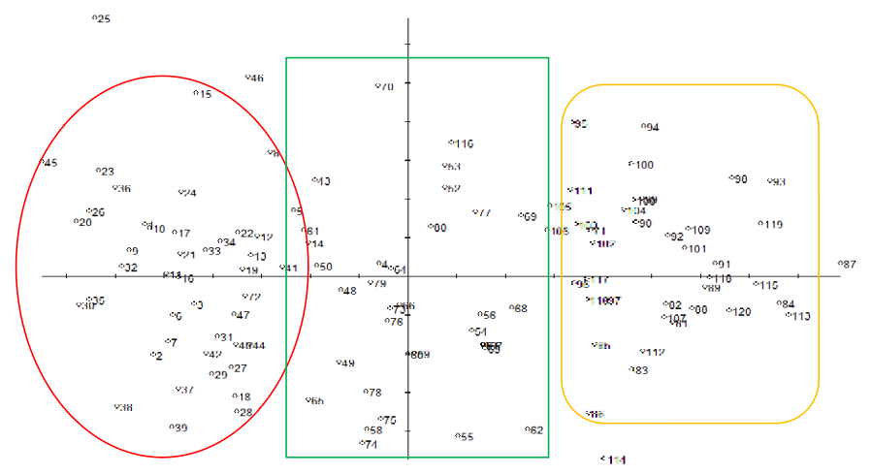
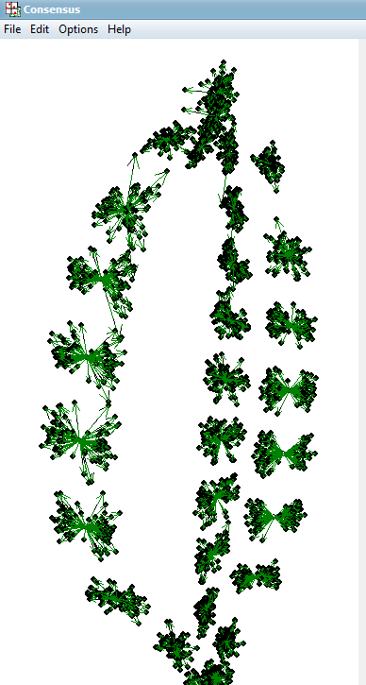
Size and Shape Analysis of Indian Rice Varieties (Oryza sativa)

Slide 6
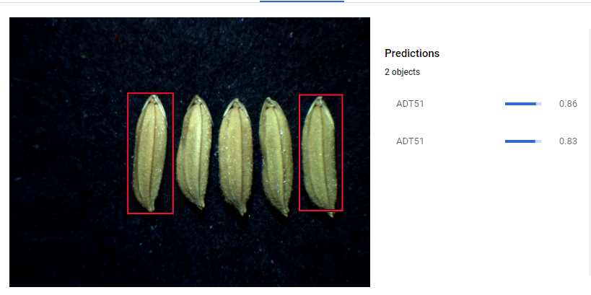
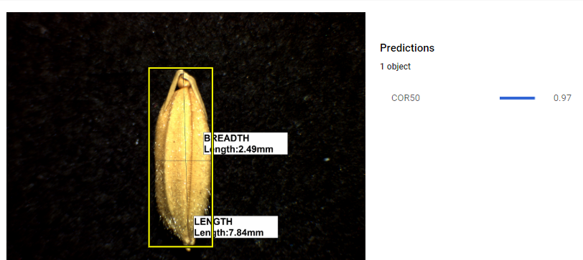
Preliminary Results; Deep Learning Algorithms ...

Slide 7
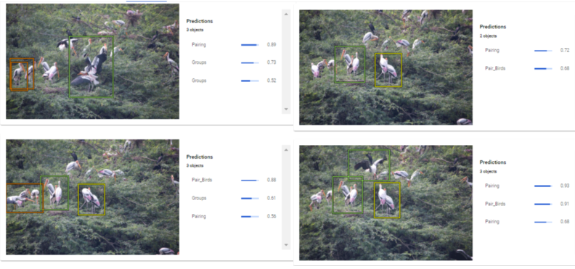
Preliminary Results; Deep Learning Algorithms ...

Slide 8
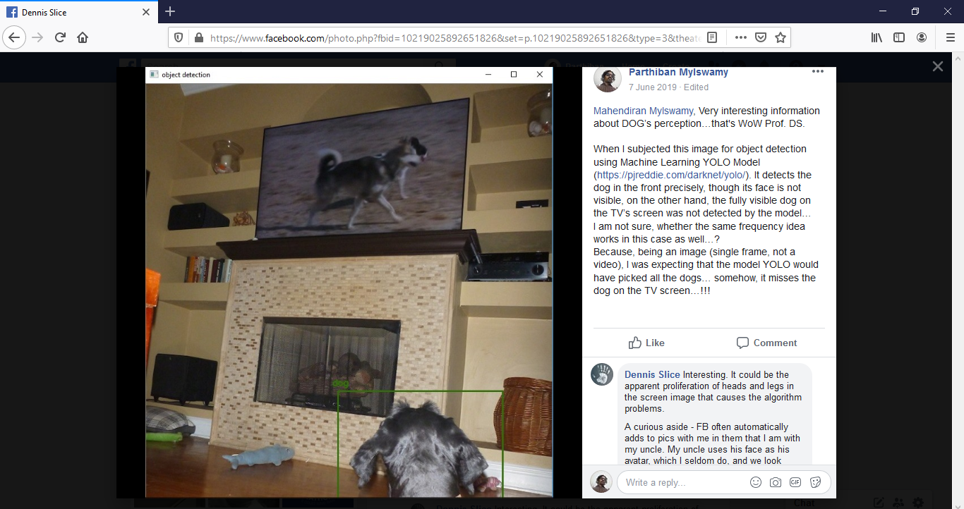
Machine Learning Models ...

Slide 9
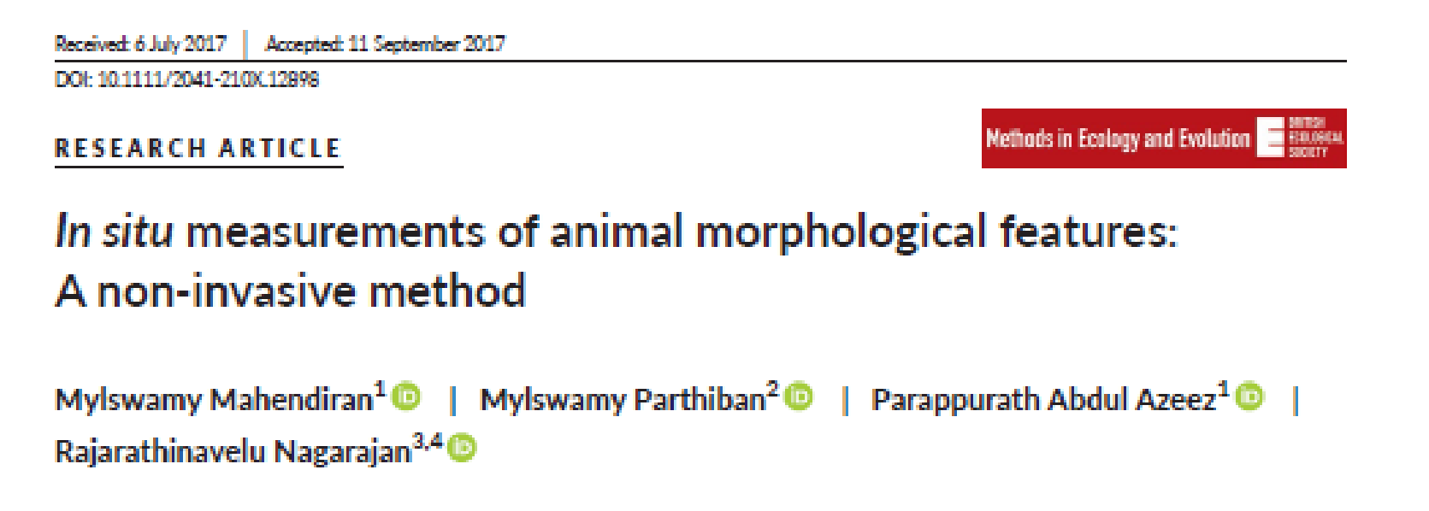
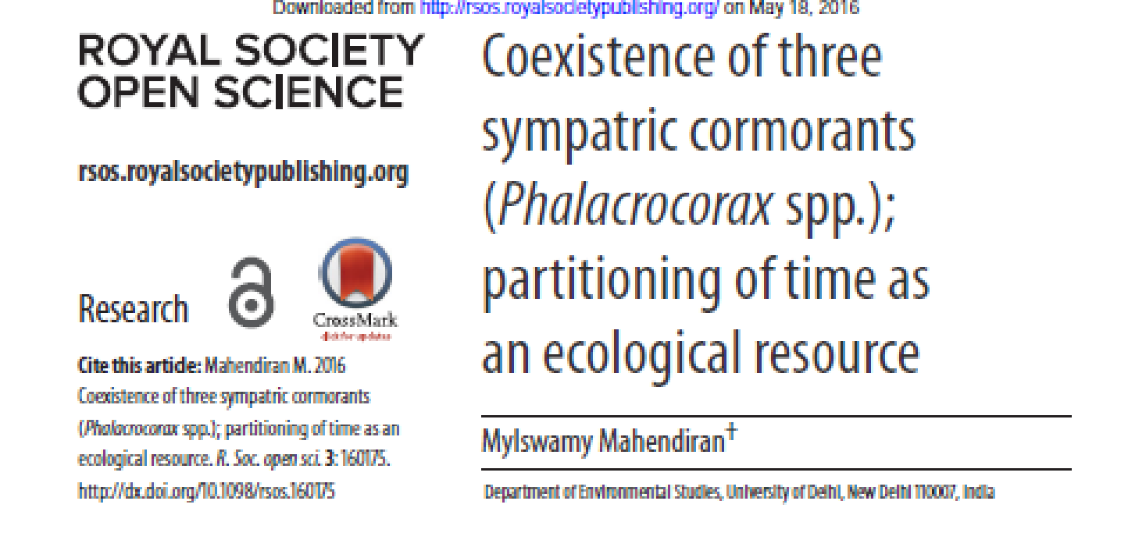
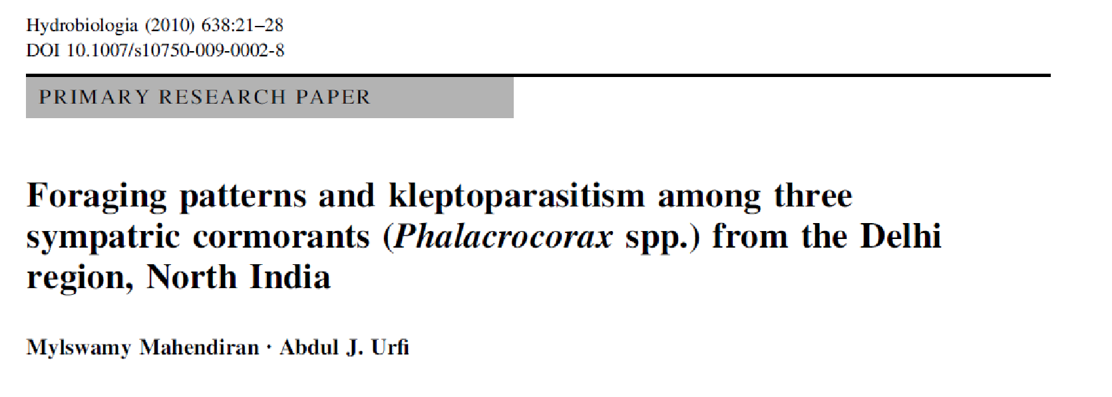
Thank You

